Slide 1
Facemask Detector…

Slide 2
Objective:
Development of a DL predictive classification model for facemask detection:
Detection of facemask
Easy to classify the images / frames of live feed..

Slide 3
Data :
Number of Columns
Column names
Column data type

Slide 4
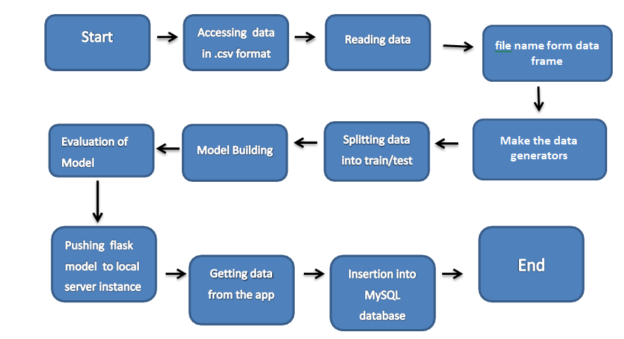
Architecture

Slide 5
Data Validation and Data Transformation :
Name Validation – Validation of the file using the pandas read.
Number of Columns – Validation of number of columns present in the .csv files, and if it doesn't meet the specification then the file is removed.
Name of Columns - The name of the columns is validated and should be the same as given in the schema file. If not, file to discarded.

Slide 6
Model Training:
Data Import from local memory :
The accumulated data from memory is exported in csv format for model training
Data Preprocessing
Encode the categorical values with numeric values.
Get the pre trained DL image processing models like MobileNetV2
Train the model until the best accuracy is received.

Slide 7
Model Selection –
Deploying as many number of pre trained models to get the best results.
Once we the get the good accuracy of the model then use the model future predictions of images as well as the live feed using OpenCV library..

Slide 8
Prediction:
The testing files are shared in the batches and we perform the same Validation operations ,image transformation and data insertion on them.
The accumulated data from local file system is exported in csv format for prediction
We perform data pre-processing techniques on it.
Pre trained model is loaded for the preprocessed data is predicted
Once the prediction is done for all the testing data. The predictions are saved in csv format and shared.

Slide 9
Data Insertion in Database:
Table creation :- Table name “predictions" is created in the database for inserting the files. If the table is already present then new files are inserted in the same table.
Insertion of files in the table - All the files in the user interface are to be inserted along with the prediction result in the above-created table.

Slide 10
Q & A:
Q1) What’s the source of data?
The data for training is provided by the client in images
Q 2) What was the type of data?
The data was the combination of image and categorical data.

Slide 11
Q 3) How logs are managed?
We are using different logs as per the steps that we follow in validation and
modeling like File validation log , Data Insertion ,Model Training log , prediction log
etc.
Q 4) What techniques were you using for data pre-processing?
Converting categorical data into one hot representation values.

Slide 12
Q 5) How training was done or what models were used?
Divide the data to training and validation data.
Use the best image preprocessing models like MobileNetV2 get the best model, final model was saved .
Q 6) How Prediction was done?
The testing files are shared by the user .We Perform the same life cycle till the data preprocessing. In the end we get the accumulated data of predictions.

Slide 13
Q 7) What are the different stages of deployment?
When the model is ready we deploy it in local environment or AWS, GCP or Azure .(Here used only local environment only and also the Render web hosting..)

